Slide 1


Sitecore Hackathon 2021
Team: Lame Horse
Category: Best use of SPE

Slide 2
Module Purpose
Team: Lame Horse - Category: Best use of SPE

Slide 3
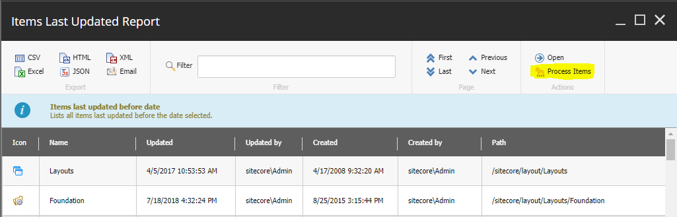
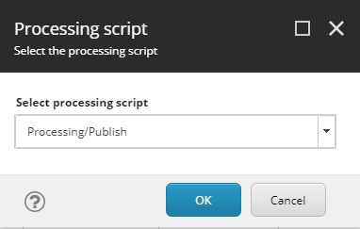
Extends the SPE Reporting List View window, allowing Content Authors and Marketers to process the results in multiple ways.
Team: Lame Horse - Category: Best use of SPE

Slide 4
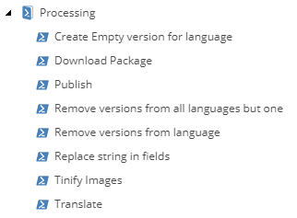
The module comes with a good number of useful processing scripts for various needs
Team: Lame Horse - Category: Best use of SPE

Slide 5
Installation
Team: Lame Horse - Category: Best use of SPE

Slide 6
Requirements
Sitecore 10.1
Sitecore Powershell Extensions 6.2
Installation
Install package LameHorse.Horseshoes-1.0.zip using Sitecore Installation Wizard
Team: Lame Horse - Category: Best use of SPE

Slide 7
Configuration
Team: Lame Horse - Category: Best use of SPE

Slide 8


Configuration (optional)
External integrations:
TinyPNG – Image optimization /sitecore/system/Modules/PowerShell/Script Library/Horseshoes/Reporting/Processing/Tinify Images
Cognitive Services – Content translation /sitecore/system/Modules/PowerShell/Script Library/Horseshoes/Reporting/Processing/Translate
Team: Lame Horse - Category: Best use of SPE

Slide 9
Usage: Reports as lists of items
Team: Lame Horse - Category: Best use of SPE

Slide 10
Usage: processing scripts
Team: Lame Horse - Category: Best use of SPE

Slide 11
Publish items
Team: Lame Horse - Category: Best use of SPE

Slide 12
Replace string in fields
Team: Lame Horse - Category: Best use of SPE

Slide 13
Download package
Team: Lame Horse - Category: Best use of SPE

Slide 14
Optimize images
Team: Lame Horse - Category: Best use of SPE

Slide 15
Translate items
Team: Lame Horse - Category: Best use of SPE

Slide 16
Remove versions for languages
Team: Lame Horse - Category: Best use of SPE

